Slide 1
Computer Algorithms
Segment 4
Greedy Method

Slide 2
Overview
Like dynamic programming, used to solve optimization
problems.
Dynamic programming can be overkill; greedy algorithms
tend to be easier to code
Problems exhibit optimal substructure (like DP).
Problems also exhibit the greedy-choice property.
  When we have a choice to make, make the one that looks
  best right now.
  Make a locally optimal choice in hope of getting a
  globally optimal solution.

Slide 3
Greedy Strategy
The choice that seems best at the moment is the one we go with.
  Prove that when there is a choice to make, one of the optimal choices is the greedy choice. Therefore, it’s always safe to make the greedy choice.
  Show that all but one of the subproblems resulting from the greedy choice are empty.
The activity-selection problem, for which a greedy algorithm efficiently computes a solution, works well for a wide range of problems, i.e, minimum-spanning-tree algorithms, Dijkstra's algorithm for shortest paths form a single source, and Chvátal's greedy set-covering heuristic.

Slide 4
Greedy Strategy (con.)
The first key ingredient is the greedy-choice property: a globally optimal solution can be arrived at by making a locally optimal (greedy) choice.
In a greedy algorithm, choice is determined on fly at each step, (while algorithm progresses), may seem to be best at the moment and then solves the subproblems after the choice is made. The choice made by a greedy algorithm may be depend on choices so far, but it cannot depend on any future choices or on the solutions to subproblems. Thus, unlike dynamic programming, which solves the subproblems bottom up, a greedy strategy usually progresses in a top-down fashion, making one greedy choice after another, iteratively reducing each given problem instance to a smaller one.

Slide 5
Greedy Strategy (con.)
Algorithms for optimization problems typically go through a sequence of steps, using dynamic programming to determine the best choices, (bottom-up) for subproblem solutions.
But in many cases much simpler, more efficient algorithms are possible. A greedy algorithm always makes the choice for a locally optimal solution which seems the best at the current moment with the hope of a globally optimal solution. In the most cases does not always yield optimal solutions, but for many problems.
Greedy algorithms constructs a solution to an optimization problem piece by piece through a sequence of choices that are:
  Feasible
  Locally optimal
  Irrevocable (binding and abiding)

Slide 6
Greedy Strategy (con.)
Start with a solution to a small subproblem
Build up to a solution to the whole problem
Make choices that look good in the short term
Disadvantage: Greedy algorithms don’t always work ( Short term solutions can be diastrous in the long term). Hard to prove correct
Advantage: Greedy algorithm work fast when they work. Simple algorithm, easy to implement

Slide 7
Applications of the Greedy Strategy
Optimal solutions:
  change making for “normal” coin denominations
  minimum spanning tree (MST)
  single-source shortest paths
  simple scheduling problems
  Huffman codes
Approximations:
  traveling salesman problem (TSP)
  knapsack problem
  other combinatorial optimization problems

Slide 8
Greedy Algorithm Design
Comparison:
Dynamic Programming
Greedy Algorithms
At each step, the choice is determined based on solutions of subproblems.
At each step, we quickly make a choice that currently looks best.
--A local optimal (greedy) choice.
Sub-problems are solved first.
Greedy choice can be made first before solving further sub-problems.
Bottom-up approach
Top-down approach
Can be slower, more complex
Usually faster, simpler

Slide 9
Activity selection problem
The problem is to select a maximum-size set of mutally compatible activities.
Example
We have a set S = { 1,2,…,n} of n proposed activities that wish to use a resource, such as a lecture hall, which can be used by only one activities at a time.
Input: Set S of n activities, a₁, a₂, …, a_{n}.
  s_{i} = start time of activity i.
  f_{i} = finish time of activity i.
Output: Subset A of maximum number of compatible activities.
  Two activities are compatible, if their intervals don’t overlap.

Slide 10
Activity selection problem(con.)
Example:
Activities in each line
are compatible.

Slide 11
Activity selection problem(con.)
An activity selection problem
  To select a maximum-size subset of mutually compatible activities.
  For example
    Given n classes and 1 lecture room,
    to select the maximum number of classes
  A set of activities: S = {a₁, a₂, ..., a_{n}}
  Each activity a_{i} has its start time s_{i} and finish time f_{i}.
    0 ≤ s_{i} < f_{i} < ∞
  Activity a_{i} takes place during [s_{i}, f_{i})
  Activities a_{i} and a_{j} are compatible
  if the intervals [s_{i}, f_{i}) and [s_{j} f_{j}) do not overlap.

Slide 12
Activity selection problem(con.)
i | 1 | 2 | 3 | 4 | 5 | 6 | 7 | 8 | 9 | 10 | 11
s_{i} | 1 | 3 | 0 | 5 | 3 | 5 | 6 | 8 | 8 | 2 | 12
f_{i} | 4 | 5 | 6 | 7 | 8 | 9 | 10 | 11 | 12 | 13 | 14
0 1 2 3 4 5 6 7 8 9 10 11 12 13 14
a1
a2
a3
a4
a5

Slide 13
Activity selection problem(con.)
0 1 2 3 4 5 6 7 8 9 10 11 12 13 14
a1
a2
a3
a4
a5
a6
a7
a8
a9
a10
a11

Slide 14
Activity selection problem(con.)
{a3, a9, a11}: mutually compatible activities, not a largest set
0 1 2 3 4 5 6 7 8 9 10 11 12 13 14
a1
a2
a3
a4
a5
a6
a7
a8
a9
a10
a11

Slide 15
Activity selection problem(con.)
{a1, a4, a8, a11}: A largest set of mutually compatible activities
0 1 2 3 4 5 6 7 8 9 10 11 12 13 14
a1
a2
a3
a4
a5
a6
a7
a8
a9
a10
a11

Slide 16
Activity selection problem(con.)
{a2, a4, a9, a11}: Another largest subset
0 1 2 3 4 5 6 7 8 9 10 11 12 13 14
a1
a2
a3
a4
a5
a6
a7
a8
a9
a10
a11

Slide 17
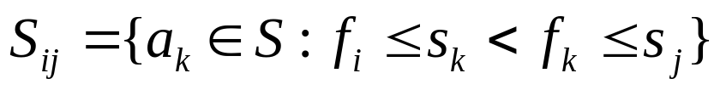
Activity selection problem(con.)
Optimal substructure
  S_{ij} denote the set of activities between a_{i} and a_{j} and compatible with a_{i} and a_{j}.
    Activities start after a_{i} finishes and finish before a_{j} starts.
    For example, S₁₈ = {a₄}

Slide 18
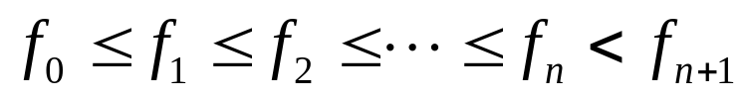
Activity selection problem(con.)
Optimal substructure
  We define a₀ and a_{n+1} such that f₀ = 0 and s_{n+1} = ∞.
  S = S_{0,n+1} for 0 ≤ i, j ≤ n + 1.
  Assume that activities are sorted in increasing order of finish time.
i | 1 | 2 | 3 | 4 | 5 | 6 | 7 | 8 | 9 | 10 | 11
s_{i} | 1 | 3 | 0 | 5 | 3 | 5 | 6 | 8 | 8 | 2 | 12
f_{i} | 4 | 5 | 6 | 7 | 8 | 9 | 10 | 11 | 12 | 13 | 14

Slide 19
Activity selection problem(con.)
Optimal substructure
  A_{ij} denote an optimal solution to S_{ij} for i ≤ j.
  If A_{ij} includes a_{k}, A_{ij} = A_{ik} U {a_{k}} U A_{kj}
ai
aj
ak

Slide 20
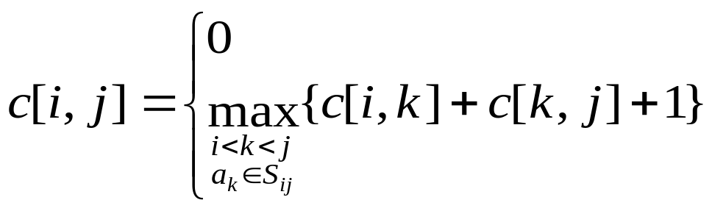
Activity selection problem(con.)
Optimal substructure
  c[i, j]: The number of activities in A_{ij}.
if Sij= Ø
if Sij≠ Ø
ai
aj
ak

Slide 21
Activity selection problem(con.)
Greedy algorithm
  Consider any nonempty S_{ij}, and let a_{m} be the activity in S_{ij} with the earliest finish time: f_{m} = min {f_{k} : a_{k} ∈S_{ij}}.
1. Activity a_{m} is in some A_{ij}.
  2. The subproblem S_{im} is empty, so that choosing a_{m} leaves the subproblem S_{mj} as the only one that may be nonempty.

Slide 22
Activity selection problem(con.)
Activity a_{m} is in some A_{ij}.
  a_{k}: the first activity in A_{ij}
  If a_{k} = a_{m}, done.
  If a_{k} ≠ a_{m} , remove a_{k} from A_{ij} add a_{m}. The resulting A_{ij} is another optimal solution because f_{m} ≤ f_{k}.
am
ak

Slide 23
Activity selection problem(con.)
The subproblem S_{im} is empty, so that choosing a_{m} leaves the subproblem S_{mj} as the only one that may be nonempty.
  S_{im} is empty because a_{m} has the earlier finish time in S_{ij}.
am

Slide 24
Activity selection problem(con.)
Greedy algorithm
  Select the earliest finishing activity one by one.
0 1 2 3 4 5 6 7 8 9 10 11 12 13 14
a1
a1
a2
a3
a4
a4
a5
a6
a7
a8
a8
a9
a10
a11
a11

Slide 25

Activity-Selection Problem
0 if S_{i,j}=Ø
eg. S_{2,11}={a₄,a₆,a₇,a₈,a₉}
c(i,j) =
Max_{i<k<j} {c[i,k]+c[k,j]+1} if S_{i,j}≠Ø
time
a₁
a₂
a₃
a₄
a₅
a₆
a₇
a₈
a₉
a₁₀
a₁₁
0
1
2
3
4
Consider any nonempty subproblem S_{i,j}, and let a_{m} be the activity in S_{i,j} with the earliest finish time.
5
ok
ok
6
ok
ok
ok
7
ok
ok
8
ok
ok
ok
ok
9
ok
ok
ok
10
ok
ok
11
ok
12
Then,
1. A_{m} is used in some maximum-size subset of compatible activities of S_{i,j}.
13
14
Among {a₄,a₆,a₇,a₈,a₉}, a₄ will finish earliest
1. A₄ is used in the solution
2. After choosing A₄, there are 2 subproblems: S_{2,4} and S_{4,11}. But S_{2,4} is empty. Only S₄,₁₁ remains as a subproblem.
2. The subproblem S_{i,m} is empty, so that choosing a_{m} leaves the subproblem S_{m,j} as the only one that may be nonempty.

Slide 26
Activity-Selection Problem
Hence, to solve the S_{i,j}:
1. Choose the activity a_{m} with the earliest finish time.
2. Solution of S_{i,j} = {a_{m}} U Solution of subproblem S_{m,j}
time
a₀
a₁
a₂
a₃
a₄
a₅
a₆
a₇
a₈
a₉
a₁₀
a₁₁
a₁₂
0
1
2
3
4
5
6
7
8
9
10
11
12
13
14
That is,
To solve S_{0,12}, we select a₁ that will finish earliest, and solve for S_{1,12.}
To solve S_{1,12}, we select a₄ that will finish earliest, and solve for S_{4,12.}
To solve S_{4,12}, we select a₈ that will finish earliest, and solve for S_{8,12.}
…
∞
Greedy Choices (Locally optimal choice)
To leave as much opportunity as possible for the remaining activities to be scheduled.
Solve the problem in a top-down fashion

Slide 27
Activity-Selection Problem
Greedy Strategy Solution
Recursive-Activity-Selector(i,j)
1 m = i+1
// Find first activity in S_{i,j}
2 while m < j and start_time_{m} < finish_time_{i}
3 do m = m + 1
4 if m < j
5 then return {a_{m}} U Recursive-Activity-Selector(m,j)
6 else return Ø
m=2
Okay
m=3
Okay
m=4
break the loop
time
a₀
a₁
a₂
a₃
a₄
a₅
a₆
a₇
a₈
a₉
a₁₀
a₁₁
a₁₂
Order of calls:
Recursive-Activity-Selector(0,12)
Recursive-Activity-Selector(1,12)
Recursive-Activity-Selector(4,12)
Recursive-Activity-Selector(8,12)
Recursive-Activity-Selector(11,12)
0
{1,4,8,11}
1
2
{4,8,11}
3
4
5
{8,11}
6
7
8
{11}
9
10
11
Ø
12
13
14
∞

Slide 28
Activity-Selection Problem
Greedy Strategy Solution
Iterative-Activity-Selector()
1 Answer = {a₁}
2 last_selected=1
3 for m = 2 to n
4 if start_time_{m}>=finish_time_{last_selected}
5 then Answer = Answer U {a_{m}}
6 last_selected = m
7 return Answer
time
a₀
a₁
a₂
a₃
a₄
a₅
a₆
a₇
a₈
a₉
a₁₀
a₁₁
a₁₂
0
1
2
3
4
5
6
7
8
9
10
11
12
13
14
∞

Slide 29


Huffman Codes
Huffman Codes
For compressing data (sequence of characters)
Widely used
Very efficient (saving 20-90%)
Use a table to keep frequencies of occurrence of characters.
Output binary string.
“Today’s weather is nice”
“001 0110 0 0 100 1000 1110”

Slide 30
Huffman Codes
Example:
Frequency Fixed-length Variable-length
codeword codeword
‘a’ 45000 000 0
‘b’ 13000 001 101
‘c’ 12000 010 100
‘d’ 16000 011 111
‘e’ 9000 100 1101
‘f’ 5000 101 1100
A file of 100,000 characters. Containing only ‘a’ to ‘e’
1*45000 + 3*13000 + 3*12000 + 3*16000 + 4*9000 + 4*5000
= 224,000 bits
1*45000 + 3*13000 + 3*12000 + 3*16000 + 4*9000 + 4*5000
= 224,000 bits
300,000 bits
eg. “abc” = “0101100”
eg. “abc” = “000001010”

Slide 31
A file of 100,000 characters.
Huffman Codes
The coding schemes can be represented by trees:
Frequency Fixed-length
(in thousands) codeword
‘a’ 45 000
‘b’ 13 001
‘c’ 12 010
‘d’ 16 011
‘e’ 9 100
‘f’ 5 101
Frequency Variable-length
(in thousands) codeword
‘a’ 45 0
‘b’ 13 101
‘c’ 12 100
‘d’ 16 111
‘e’ 9 1101
‘f’ 5 1100
Not a full
binary tree
0
100
100
A full binary tree
every nonleaf node
has 2 children
0
1
1
1
1
0
86
14
a:45
55
0
0
1
1
0
0
1
0
28
58
28
14
58
25
30
1
1
1
1
0
0
1
0
0
1
1
0
0
0
1
0
a:45
a:45
a:45
b:13
b:13
b:13
c:12
c:12
c:12
d:16
d:16
d:16
e:9
e:9
e:9
f:5
f:5
f:5
b:13
c:12
14
d:16
0
1
e:9
f:5

Slide 32
Huffman Codes
Frequency Codeword
‘a’ 45000 0
‘b’ 13000 101
‘c’ 12000 100
‘d’ 16000 111
‘e’ 9000 1101
‘f’ 5000 1100
To find an optimal code for a file:
1. The coding must be unambiguous.
  Consider codes in which no codeword is also a prefix of other codeword. => Prefix Codes
  Prefix Codes are unambiguous.
  Once the codewords are decided, it is easy to compress (encode) and decompress (decode).
2. File size must be smallest.
  => Can be represented by a full binary tree.
  => Usually less frequent characters are at bottom
  Let C be the alphabet (eg. C={‘a’,’b’,’c’,’d’,’e’,’f’})
  For each character c, no. of bits to encode all c’s
  occurrences = freq_{c}*depth_{c}
  File size B(T) = Σ_{c∈C}freq_{c}*depth_{c}
0
100
1
a:45
0
55
1
25
30
0
1
0
1
b:13
c:12
14
d:16
0
1
e:9
f:5
Eg. “abc” is coded as “0101100”

Slide 33
Huffman Codes
How do we find the optimal prefix code?
Huffman code (1952) was invented to solve it.
A Greedy Approach.
Q: A min-priority queue
f:5
e:9
c:12
b:13
d:16
a:45
c:12
b:13
14
d:16
a:45
14
d:16
25
a:45
f:5
e:9
f:5
e:9
c:12
b:13
25
30
a:45
a:45
55
100
c:12
b:13
d:16
25
30
a:45
55
14
c:12
b:13
25
30
f:5
e:9
14
d:16
b:13
c:12
14
d:16
f:5
e:9
e:9
f:5

Slide 34
Huffman Codes
Q: A min-priority queue
f:5
e:9
c:12
b:13
d:16
a:45
c:12
b:13
14
d:16
a:45
14
d:16
25
a:45
f:5
e:9
f:5
e:9
c:12
b:13
….
Coding Cost of T: B(T)=∑ _{c ∈ C} f(c)d_{T}(c)
  c : each character in the alphabet C
  f(c): frequency of c
  d_{T}(c): depth of c's leaf (length of the codeword of c)
Code design: Given f(c₁), f(c₂), …, f(c_{n}), construct a binary tree with n leaves such that B(T) is minimized.
  Idea: more frequently used characters use shorter depth.
Huffman(C)
1. n ← |C|;
2. Q ← C;
3. for I ← 1 to n-1
4. z ← Allocate-Node();
5. x ← left[z] ← Extract-Min(Q);
6. y ← right[z] ← Extract-Min(Q);
7. f[z] ← f[x]+f[y];
8. Insert(Q, z);
9. return Extract-Min(Q)
Time complexity: O(n lgn).
  Extract-Min(Q) needs O(lg n) by a heap operation.
  Requires initially O(n lgn) time to build a binary heap.

Slide 35
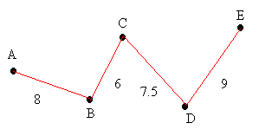
The Traveling Salesman Problem (TSP)
Understanding the TSP
Complete Graph – vertices joined by a single edge
Weighted Graph – edges carry a value

Slide 36
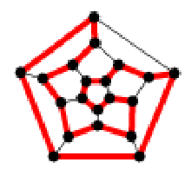
Understanding the TSP
Hamilton Circuit – connects all points on a graph, passes through each point only once, returns to origin
Optimal Hamilton Circuit – smallest possible weight

Slide 37
Finding an Approximate Solution
Cheapest Link Algorigthm
  Edge with smallest weight is drawn first
  Edge with second smallest weight is drawn in
  Continue unless it closes a smaller circuit or three edges come out of one vertex
  Finished once a complete Hamilton Circuit is drawn

Slide 38
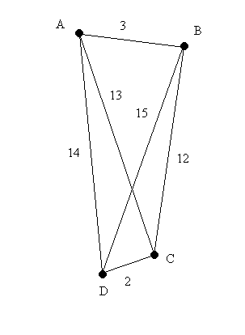
Cheapest Link Algorithm

Slide 39
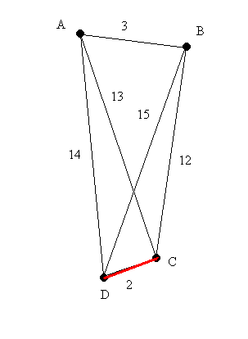
Cheapest Link Algorithm

Slide 40
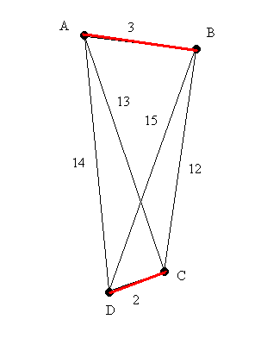
Cheapest Link Algorithm

Slide 41
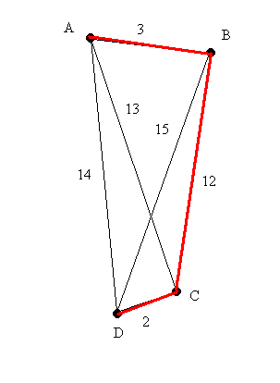
Cheapest Link Algorithm

Slide 42
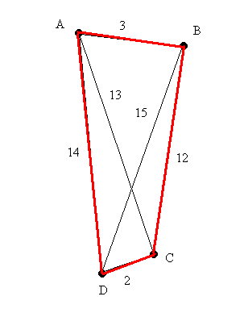
Cheapest Link Algorithm

Slide 43
Finding an Approximate Solution
Nearest Neighbor Algorithm
  Start at any given vertex
  Travel to edge that yields smallest weight and has not been traveled through yet
  Continue until we have a complete Hamilton circuit

Slide 44
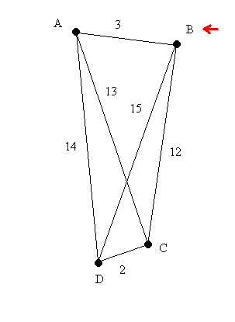
Nearest Neighbor Algorithm

Slide 45
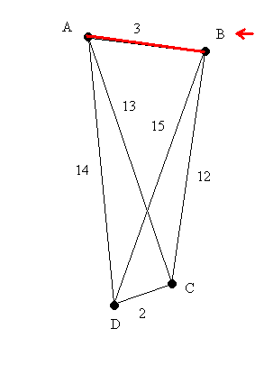
Nearest Neighbor Algorithm

Slide 46
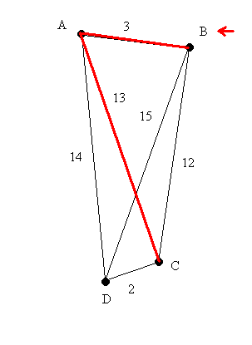
Nearest Neighbor Algorithm

Slide 47
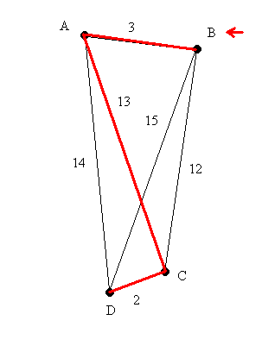
Nearest Neighbor Algorithm

Slide 48
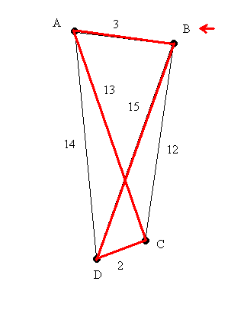
Nearest Neighbor Algorithm

Slide 49
The Nearest Neighbour Algorithm
To find a (reasonably good) Hamiltonian cycle i.e. a closed trail containing every node of a graph
Step 1 | Choose any starting node
Step 2 | Consider the arcs which join the node just chosen to nodes as yet unchosen. Pick the one with minimum weight and add it to the cycle
Step 3 | Repeat step 2 until all nodes have been chosen
Step 4 | Then add the arc that joins the last-chosen node to the first-chosen node

Slide 50
To find a (reasonably good) Hamiltonian cycle i.e. a closed trail containing every node of this graph using the Nearest Neighbour Algorithm:
A
Choose any starting node – let’s say A
6
5
6
E
Consider the arcs which join the node just chosen to nodes as yet unchosen. Pick the one with minimum weight and add it to the cycle
B
8
4
5
7
8
5
The first arc is AD as 4 is the least of 6, 8, 4 and 5
C
7
D
From D, DE is chosen as 5 is the least of 7, 7, and 5
A
Then EB,
BC,
and finally CA
B
6
E
8
4
The cycle is ADEBCA which has weight 28 (5 + 5 + 6 + 4 + 8)
5
5
The Nearest Neighbour Algorithm is ‘greedy’ because at each stage the immediately best route is chosen, without a look ahead, or back, to possible future problems or better solutions.
C
D

Slide 51
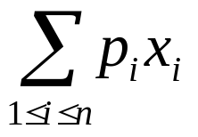
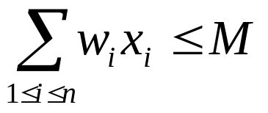
Knapsack Problem
We are given n objects and a knapsack. Object i has a weight w_{i} and the knapsack has a capacity M.
If a fraction x_{i}, 0 ≤ x_{i} ≤ 1, of object i is placed into the knapsack then a profit of p_{i}x_{i} is earned.
The objective is to obtain a filling of the knapsack that maximizes the total weight of all chosen objects to be at most M
maximize
subject to
and 0 ≤ xi ≤ 1, 1 ≤ i ≤ n

Slide 52

Example
50
Item 3
Item 2
30
Item 1
20
10
$60
$100
$120
knapsack

Slide 53
Knapsack 0/1
30
30
$120
$100
$120
20
20
$100
10
$60
$60
10
Total
=$220
=$160
=$180

Slide 54
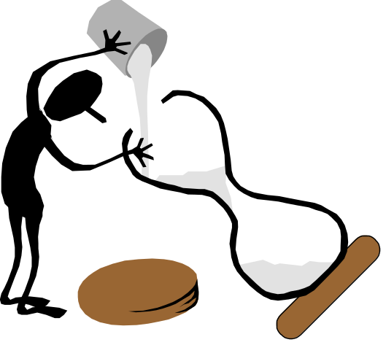
Fractional Knapsack
Taking the items in order of greatest value per pound yields an optimal solution
20
30
$80
20
$100
10
$60
Total
=$240

Slide 55

Optimal Substructure
Both fractional knapsack and 0/1 knapsack have an optimal substructure.

Slide 56
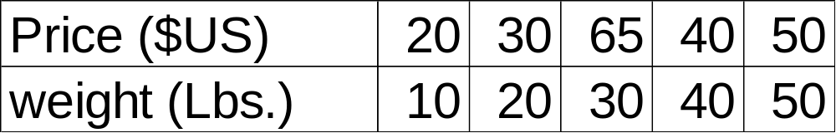
Example Fractional Knapsack (cont.)
There are 5 objects that have a price and weight list below, the knapsack can contain at most 100 Lbs.
Method 1 choose the least weight first
  Total Weight = 10 + 20 + 30 + 40 = 100
  Total Price = 20 + 30 + 65 + 40 = 155

Slide 57
Example Fractional Knapsack (cont.)
Method 2 choose the most expensive first
  Total Weight = 30 + 50 + 20 = 100
  Total Price = 65 + 60 + 20 = 145

Slide 58
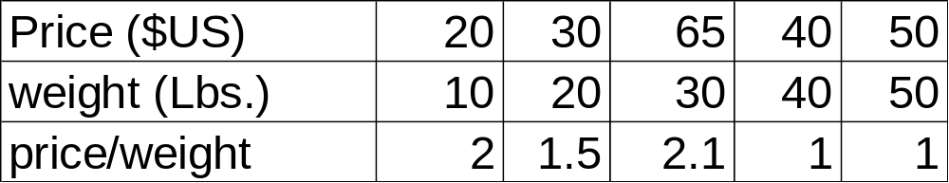
Example Fractional Knapsack (cont.)
Method 3 choose the most price/ weight first
  Total weight = 30 + 10 + 20 + 40 = 100
  Total Price = 65 + 20 + 30 + 48 = 163

Slide 59
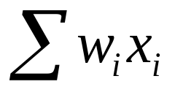
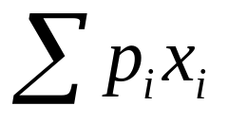
More Example on fractional knapsac
Consider the following instance of the knapsack problem: n = 3, M = 20, (p₁,p₂,p₃) = 25,24,15 and (w₁,w₂,w₃) = (18,15,10)
(x1,x2,x3)
1) (1/2,1/3,1/4) 16.5 24.25
2) (1,2/15,0) 20 28.2
3) ( 0,2/3,1) 20 31
4) ( 0,1,1/2) 20 31.5

Slide 60
PseudoCode
Algorithm GreedyKnapsack(m,n)
//p(1:n) and w(1:n) contain the profits and weights respectively of the n objects
// ordered so that p(i)/w(i) > p(i+1)/w(i+1). m is the knapsack size and x(1:n) is
// the solution vector
{
for i:=1 to n do x[i]:=0.0; // Initialized x.
U:=m;
for i:=1 to n do
{
if(w[i]>U) then break;
x[i] :=1.0; U:=U-w[i];
}
if (i<=n) then x[i] :=U/w[i];
}

Slide 61
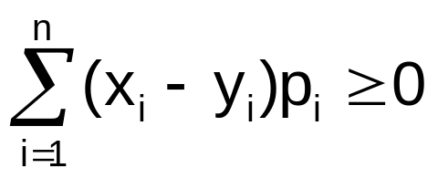
Proving Optimality
Let p₁/w₁ > p₂/w₂ > … > p_{n}/w_{n}
Let X = (x₁,x₂,…,x_{n}) be the solution generated by GREEDY_KNAPSACK
Let Y = (y₁,y₂,…,y_{n}) be any feasible solution
We want to show that

Slide 62
Proving Optimality (cont.)
If all the x_{i} are 1, then the solution is clearly optimal (It is the only solution) otherwise, let k be the smallest number such that x_{k} < 1.
1
2
n
1
1
1
1
1
1
1
1
1
1
1
1
1
2
k
n
1
1
..
..
1
x_{k}
0
0
..
..
0
0

Slide 63
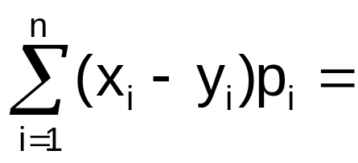
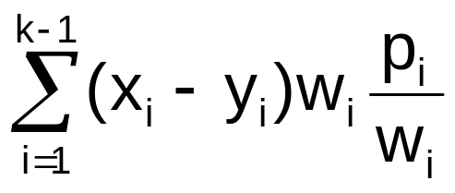
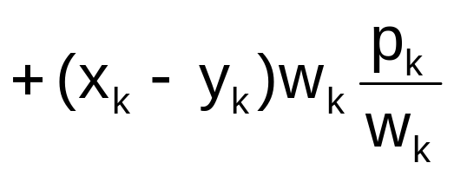
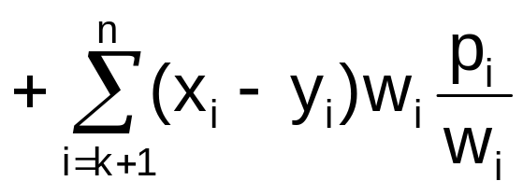
Proving Optimality (cont.)
1
2
k
n
1
1
..
..
1
x_{k}
0
0
..
..
0
0
1
2
3

Slide 64
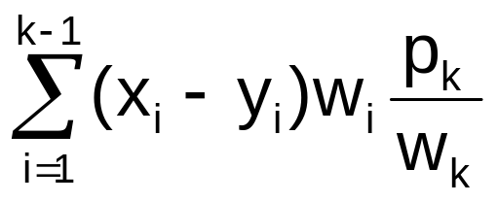

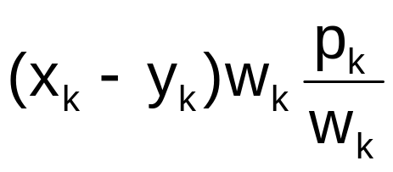

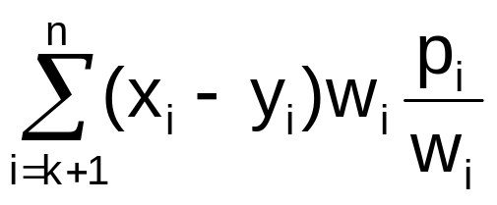
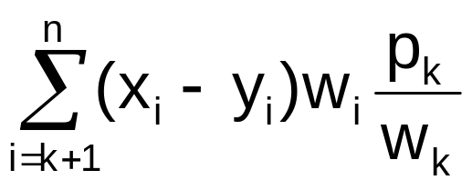
Proving Optimality (cont.)
Consider each of these block

Slide 65
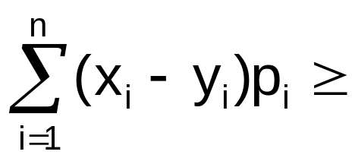

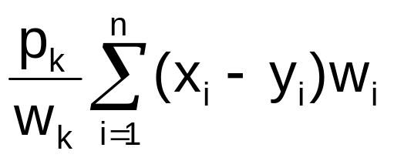
Proving Optimality (cont.)
= W
Since W always > 0, therefore

